Slide 1
Lecture 02: More on Memory and I/O Modules

Slide 2
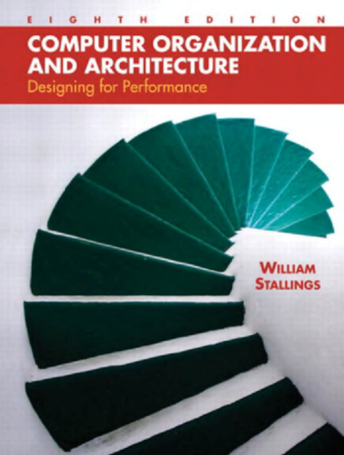
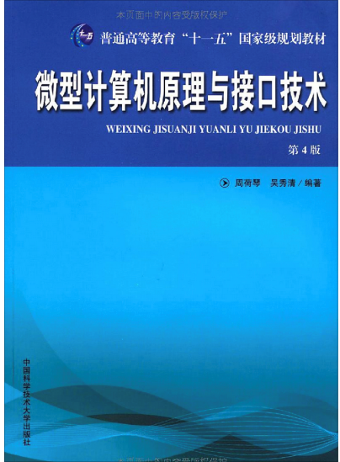
Reference Book:
William Stallings Computer Organization and Architecture
Chapter 5 Internal Memory
微型计算机原理与接口技术（第四版）
第五章 存储器

Slide 3
Characteristics of Memory
Location
Capacity
Unit of transfer
Access method
Performance
Physical type
Organisation

Slide 4
Location
CPU
registers
Internal
Cache, main memory
External
Disk, tape, DVD

Slide 5
Capacity
Word size
The natural unit of organization
Number of words
E.g., 2M 8-bit, 16M 1-bit
Same capacity but different organization

Slide 6
Unit of Transfer
Internal Memory
Usually a word, governed by data bus width
External Memory
Usually a block which is much larger than a word

Slide 7
Addressable unit
Smallest location which can be uniquely addressed
Normally a Byte for internal memory
Cluster on disks

Slide 8
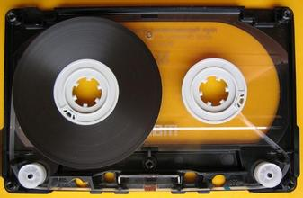
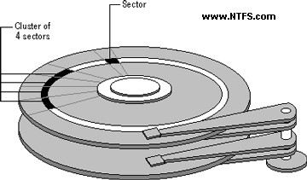
Access Methods (1)
Sequential 串行访问
Start at the beginning and read through in order
Access time depends on location of data and previous location
e.g. tape
Direct 直接访问
Individual blocks have unique address
Access is by jumping to vicinity plus sequential search
Access time depends on location and previous location
e.g. disk

Slide 9
Access Methods (2)
Random 随机访问
Individual addresses identify locations exactly
Access time is independent of location or previous access
e.g. RAM, ROM
Associative 关联访问
Data is located based on a portion of its contents rather than its address
Access time is independent of location or previous access
e.g. cache

Slide 10
Performance
Access time
Time between presenting the address and getting the valid data
Memory Cycle time
Time may be required for the memory to “recover” before next access
Cycle time is access + recovery
Transfer Rate
Rate at which data can be moved

Slide 11
Physical Types
Semiconductor
RAM
Magnetic
Disk & Tape
Optical
CD & DVD
Others
Bubble
Hologram

Slide 12
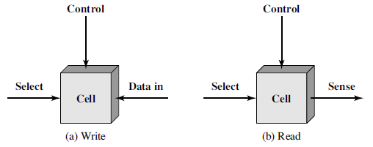
Semiconductor Memory
The basic element of a semiconductor memory is the memory cell
exhibit two stable states, representing binary 1 and 0
capable of being written into to set the state
capable of being read from to sense the state
RAM (Random Access Memory)
Misnamed as all semiconductor memory is random access
ROM (Read-Only Memory)

Slide 13
Random Access Memory (RAM)
Read/Write
Volatile
must be provided with a constant power supply
Temporary storage
When the power is gone, data are lost
Static or dynamic
SRAM or DRAM

Slide 14
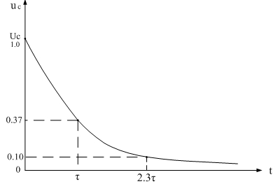
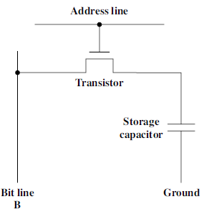
Dynamic RAM (DRAM)
Bits stored as charge in capacitors
Charges leak
Need refreshing even when powered
Simpler construction
Smaller per bit
Less expensive
Need refresh circuits
Slower
For the user of main memory

Slide 15
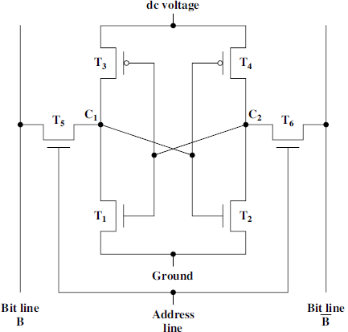
Static RAM (SRAM)
Bits stored as on/off switches
No charges to leak
No refreshing needed when powered
More complex construction
Larger per bit
More expensive
Does not need refresh circuits
Faster
For the use of cache
traditional flip-flop logic-gate configurations

Slide 16
Read Only Memory (ROM)
Permanent storage
Nonvolatile
Needs no power
Normal applications of ROM
Library subroutines
Systems programs (BIOS)
Function tables

Slide 17
Types of ROM
Written during manufacture
Very expensive for small runs
Programmable (once)
PROM
Needs special equipment to program
Read “mostly”
Erasable Programmable (EPROM)
Erased by Ultraviolet radiation
Electrically Erasable (EEPROM)
Takes much longer to write than read
Flash memory
Erase whole memory electrically

Slide 18
Memory Hierarchy 存储器层级结构
Registers
In CPU
Internal or Main memory
May include one or more levels of cache
“RAM”
External memory
Backing store

Slide 19
Hierarchy List
Registers
L1 Cache
L2 Cache
Main memory
Disk cache
Disk
Optical
Tape

Slide 20
So you want fast?
It is possible to build a computer which uses only static RAM (cache)
e.g., computers with NVM
This would be very fast
This would need no cache
This would cost a very large amount of money
Memory hierarchy is trade-offs among speed, capacity, and cost

Slide 21
Chip Organisation
Physical arrangement of bits into words
Note that this “word” is the chip word not the system word

Slide 22
Organisation in detail
A 16Mbit chip can be organised as 1M of 16-bit words
A 16Mbit chip can be organised as a 2048 x 2048 x 4bit array
Reduces number of address pins
Multiplex row address and column address
11 pins to address (2¹¹=2048)
Adding one more pin doubles range of values so x4 capacity

Slide 23
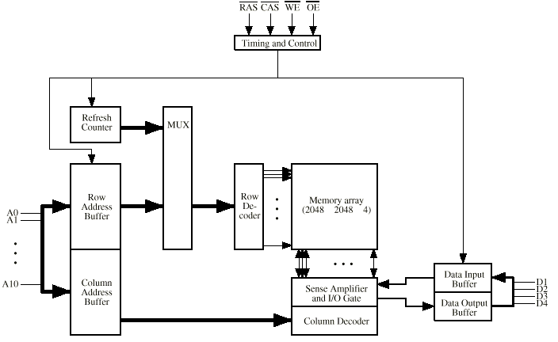
Typical 16 Mb DRAM (4M x 4)

Slide 24
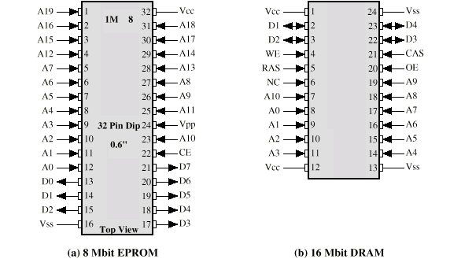
Chip Packaging

Slide 25
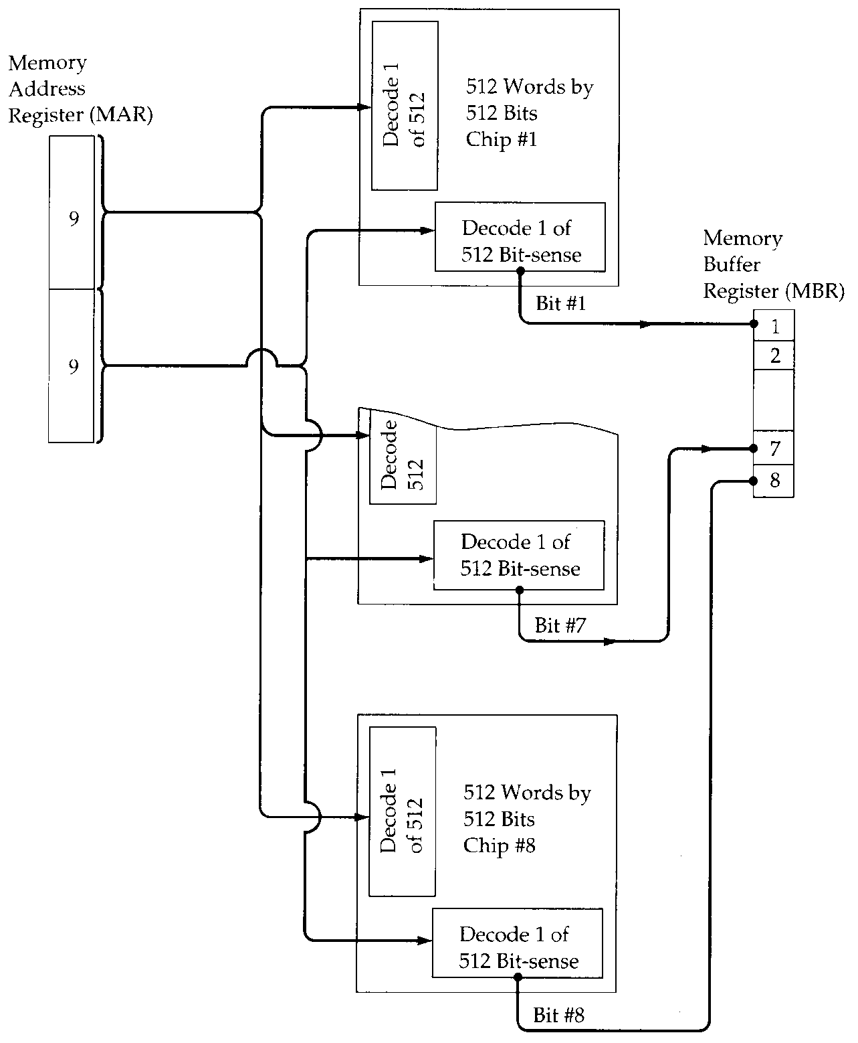
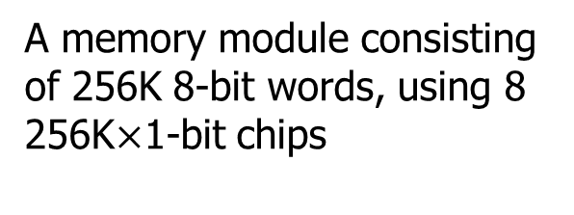
Module Organisation
A memory module consisting of 256K 8-bit words, using 8 256K$×$1-bit chips
To organize a memory module：
If the module needs bigger unit of transfer than that of given memory chips, bit extension, 位扩展
Every chip has the same address space

Slide 26
Bit Extension Example
You have 256K$×$1-bit RAM chips. How can you build a memory module of 256K$×$32-bit and how to connect this module with a computer system?
What is the addressable unit? What is the addressing scheme used in this example?
A₁₇₋₀
A₁₇₋₀

Slide 27
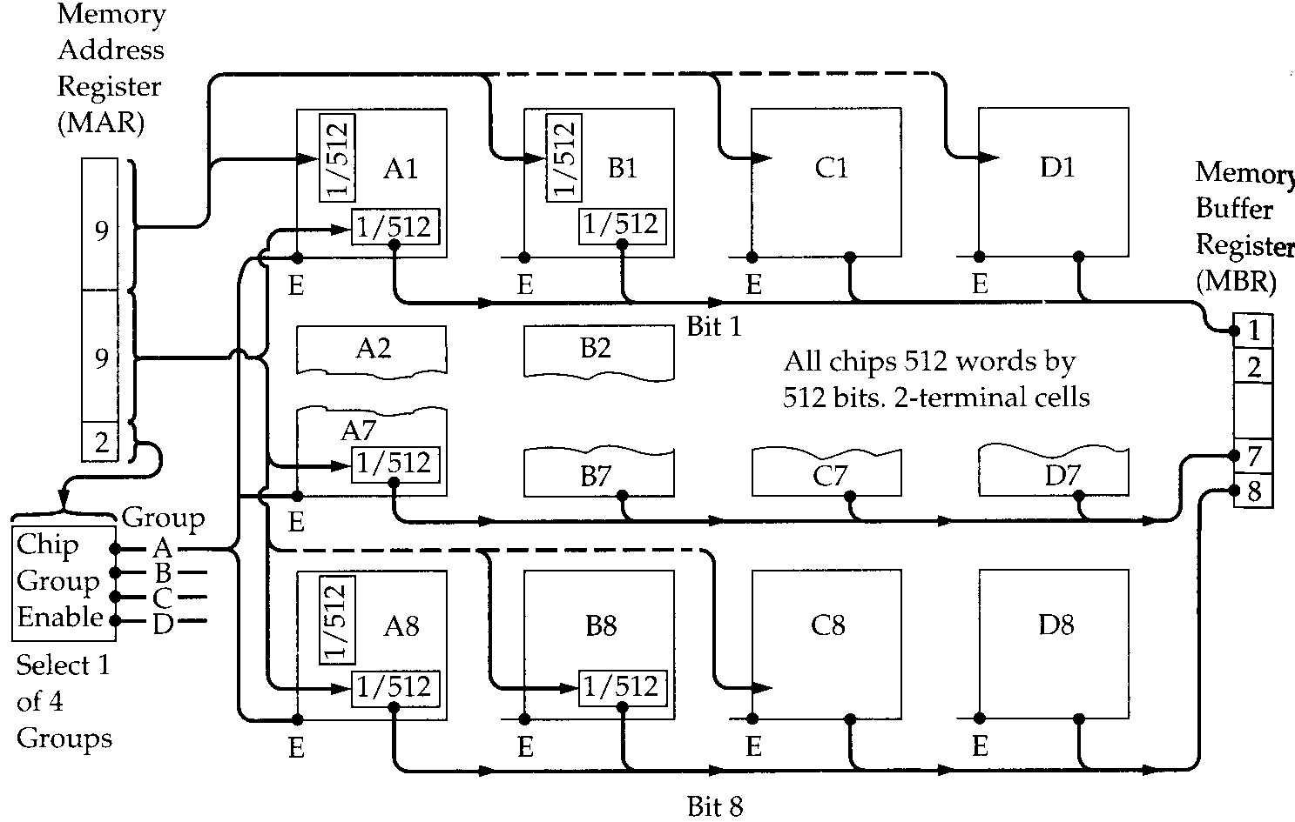
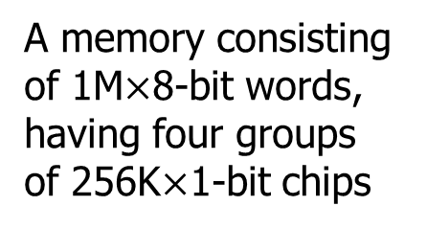
Module Organisation (2)
A memory consisting of 1M$×$8-bit words, having four groups of 256K$×$1-bit chips
To organize a memory module：
If the module needs larger number of words than that of given memory chips, word extension, 字扩展
Chips in different group has different address range

Slide 28
Word Extension Example
You have 256K$×$8-bit RAM chips. How can you build a memory module of 2M$×$8-bit and how to connect this module with a computer system?

Slide 29
Word and Bit Extension Example
Now you have 256K$×$8-bit RAM chips. How can you build a memory module of 2M$×$32-bit and how to connect this module with a computer system?
What if the addressable unit is byte?
A₂₀₋₁₈
A₂₀₋₀
A₁₇₋₀

Slide 30
Reference Book:
William Stallings Computer Organization and Architecture
Chapter 7 Input/Output
微型计算机原理与接口技术（第四版）
第六章 I/O接口和总线

Slide 31
Input/Output Problems
Wide variety of peripherals（外设）
Different operation logic
-> impractical for CPU to control all kinds of devices
Speak different "languages"
Delivering different amounts of data, e.g., serial/parallel
At different speeds
In different formats, e.g., analog/digital
-> impractical for CPU to understand
Slower than CPU and RAM
-> impractical to directly connect devices with high-speed system bus
We need I/O modules (ports)!

Slide 32
Input/Output Module
Interface to the CPU and Memory
Interface to one or more peripherals
It's like a bridge, an interpreter, a buffer, and …

Slide 33
External Devices
Human readable
Screen, printer, keyboard
Machine readable
Monitoring and control
Communication
Modem
Network Interface Card (NIC)

Slide 34
I/O Module Function
Control & Timing
CPU Communication
Device Communication
Data Buffering
Error Detection

Slide 35
I/O Steps
For example, the control of the transfer of data from an external device to the processor
CPU checks I/O module for device status
I/O module returns the device status
If the device is ready, CPU requests data transfer by means of a command to the I/O module
I/O module gets a unit of data from device
I/O module transfers the data to CPU

Slide 36
I/O Module Diagram
Interface to Systems Bus
Interface to External Device
External
Device
Interface
Logic
Data
Data
Lines
Data Register
Status
Status/Control Register
Control
Address
Lines
Input
Output
Logic
External
Device
Interface
Logic
Data
control
Lines
Status
Control

Slide 37
I/O Module Design Decisions
Hide or reveal device properties to CPU
Support multiple or single device
Control device functions or leave for CPU

Slide 38
Input Output Techniques
Programmed I/O, 程序控制I/O
Interrupt driven I/O, 中断驱动I/O
Direct Memory Access (DMA), 直接存储器访问

Slide 39
Programmed I/O
CPU executes a program that gives it direct control of the I/O operation
Sensing device status
Read/write commands to the I/O module
Transferring data
CPU waits for I/O module to complete operation

Slide 40
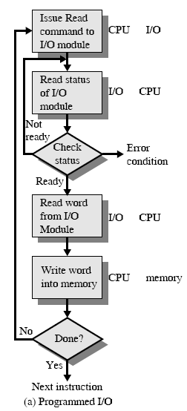
Programmed I/O - detail
CPU requests I/O operation
I/O module performs operation
I/O module sets status bits
CPU checks status bits periodically
I/O module does not inform CPU directly
I/O module does not interrupt CPU
CPU may wait or come back later (for example, with the help of time-sharing OS)

Slide 41
I/O Commands
CPU issues address
Identifies module (& device if >1 per module)
CPU issues command
Control - telling module what to do
e.g. spin up disk
Test - check status
e.g. power? Error?
Read/Write
Module transfers data via buffer from/to device

Slide 42
Addressing I/O Devices
Under programmed I/O, data transfer is very like memory access (from CPU viewpoint)
Each device is given a unique identifier
CPU commands contain the identifier (address) of the corresponding module (and device)

Slide 43
Addressing Schemes Revisited
Memory mapped I/O
Devices and memory share an address space
I/O looks just like memory read/write
No special commands for I/O
Large selection of memory access commands available
Isolated I/O
Separate address spaces
Need I/O or memory select lines
Special commands for I/O
Limited set

Slide 44
Problem with Programmed I/O?
Simple, but if CPU is faster,
it is a huge waste of CPU time

Slide 45
Interrupt Driven I/O
Overcomes CPU waiting
No repeated CPU checking of device
I/O module interrupts when ready

Slide 46
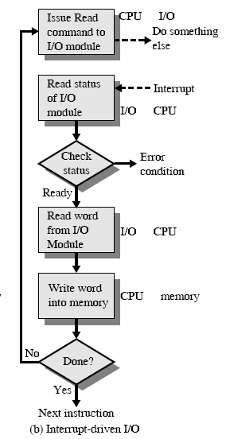
Interrupt Driven I/O Basic Operation
CPU requests I/O operation
I/O module performs operation whilst CPU does other work
I/O module informs CPU when something comes up by interrupting CPU
CPU deals with this event

Slide 47
CPU Viewpoint
Issue read command
Do other work
Check for interrupt at the end of each instruction cycle
If interrupted:-
Save context (registers)
Process interrupt
Fetch data & store
Recover from the saved context

Slide 48
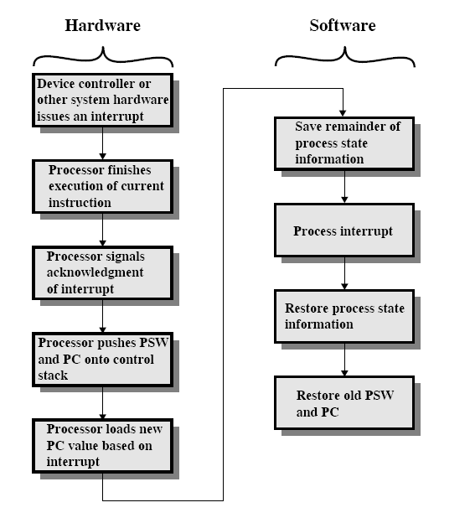

Handling an Interrupt: from a Protocol Perspective
Draw a protocol:
Which parties?
Interactions?
What’s interrupt?
New event needs CPU to handle first but CPU needs to go back to previous work after that
A program called interrupt handler
Notes:
How can the CPU know which device is generating the interrupt? What is the new PC value?

Slide 49
Design Issues
How can CPU know which module is issuing the interrupt?
when there are multiple devices connected to the system
How to locate the corresponding handler program when interrupted?
How do you deal with multiple interrupts?
Possible for more than one devices to issue an interrupt simultaneously or in a row

Slide 50
Identifying Interrupting Module (1)
Connect a dedicated line for each module
Limits the number of devices
Software poll
All devices share one common Interrupt Request line to interrupt CPU
Once get an interrupt, CPU asks each module in turn
CPU clears the interrupt request status of the module responsible

Slide 51
Identifying Interrupting Module (2)
Daisy Chain or Hardware poll
All devices share one common Interrupt Request line to interrupt CPU
Interrupt Acknowledge signal is sent down a chain
Bus Master
Module must claim the bus before it can raise interrupt
e.g. PCI & SCSI
Interrupt controller
8259

Slide 52
Localizing Handler Programs
Using a general handler program
CPU enters this handler every time it gets interrupted
looks for the module responsible and gets the address of the corresponding handler program
Using interrupt vectors
instead of using fixed locations, a handler program can be stored anywhere in memory
a pointer is used to link to the handler program
the address of the pointer is fixed and known to CPU
such pointers are interrupt vectors
Pros and cons?

Slide 53
Dealing with Multiple Interrupts
Set priorities for interrupts
i.e., high-priority interrupts get served first
Given a interrupt identification scheme, how to set priorities?
Software and hardware polling, bus mastering
Nesting of interrupts
i.e., high-priority interrupts can further interrupt low-priority interrupts

Slide 54
Problem with Programmed and Interrupt-driven I/O?
They both need the involvement of CPU.

Slide 55
Direct Memory Access
Interrupt driven and programmed I/O require active CPU intervention
Transfer rate is limited
CPU is tied up
DMA is the answer

Slide 56
DMA Function
Additional Module (hardware) on bus
DMA controller takes over from CPU for I/O

Slide 57
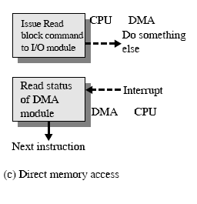
DMA Operation
CPU tells DMA controller:-
Read/Write
Device address
Starting address of memory block for data
Amount of data to be transferred
CPU carries on with other work
DMA controller deals with transfer
DMA controller sends interrupt when finished

Slide 58
DMA Transfer Cycle Stealing
In an instruction cycle, the processor may be suspended due to DMA operation
CPU suspended just before it accesses bus
DMA controller takes over bus for a cycle
Transfer of one word of data
Not an interrupt: CPU does not switch context
Slows down CPU but not as much as CPU doing transfer

Slide 59
DMA Configurations (1)
DMA
Controller
I/O
Device
I/O
Device
Main
Memory
CPU
Single Bus, Detached DMA controller
Each transfer uses bus twice
e.g., I/O to DMA then DMA to memory
For one transfer, CPU is suspended twice

Slide 60
DMA Configurations (2)
DMA
Controller
DMA
Controller
Main
Memory
CPU
I/O
Device
I/O
Device
I/O
Device
Single Bus, Integrated DMA controller
Controller may support >1 device
Each transfer uses bus once
DMA to memory
For one transfer, CPU is suspended once

Slide 61
DMA Configurations (3)
CPU
DMA
Controller
Main
Memory
I/O
Device
I/O
Device
I/O
Device
I/O
Device
Separate I/O Bus
Bus supports all DMA enabled devices
Each transfer uses bus once
DMA to memory
For one transfer, CPU is suspended once

Slide 62
Which way is the best?
Simplicity
Performance

Slide 63
Assignment Two
Go Jbox/Canvas site and download the Assignment Two
https://jbox.sjtu.edu.cn/l/5odWhf (Password:EI209)
https://oc.sjtu.edu.cn
Due on May. 6.

